Slide 1
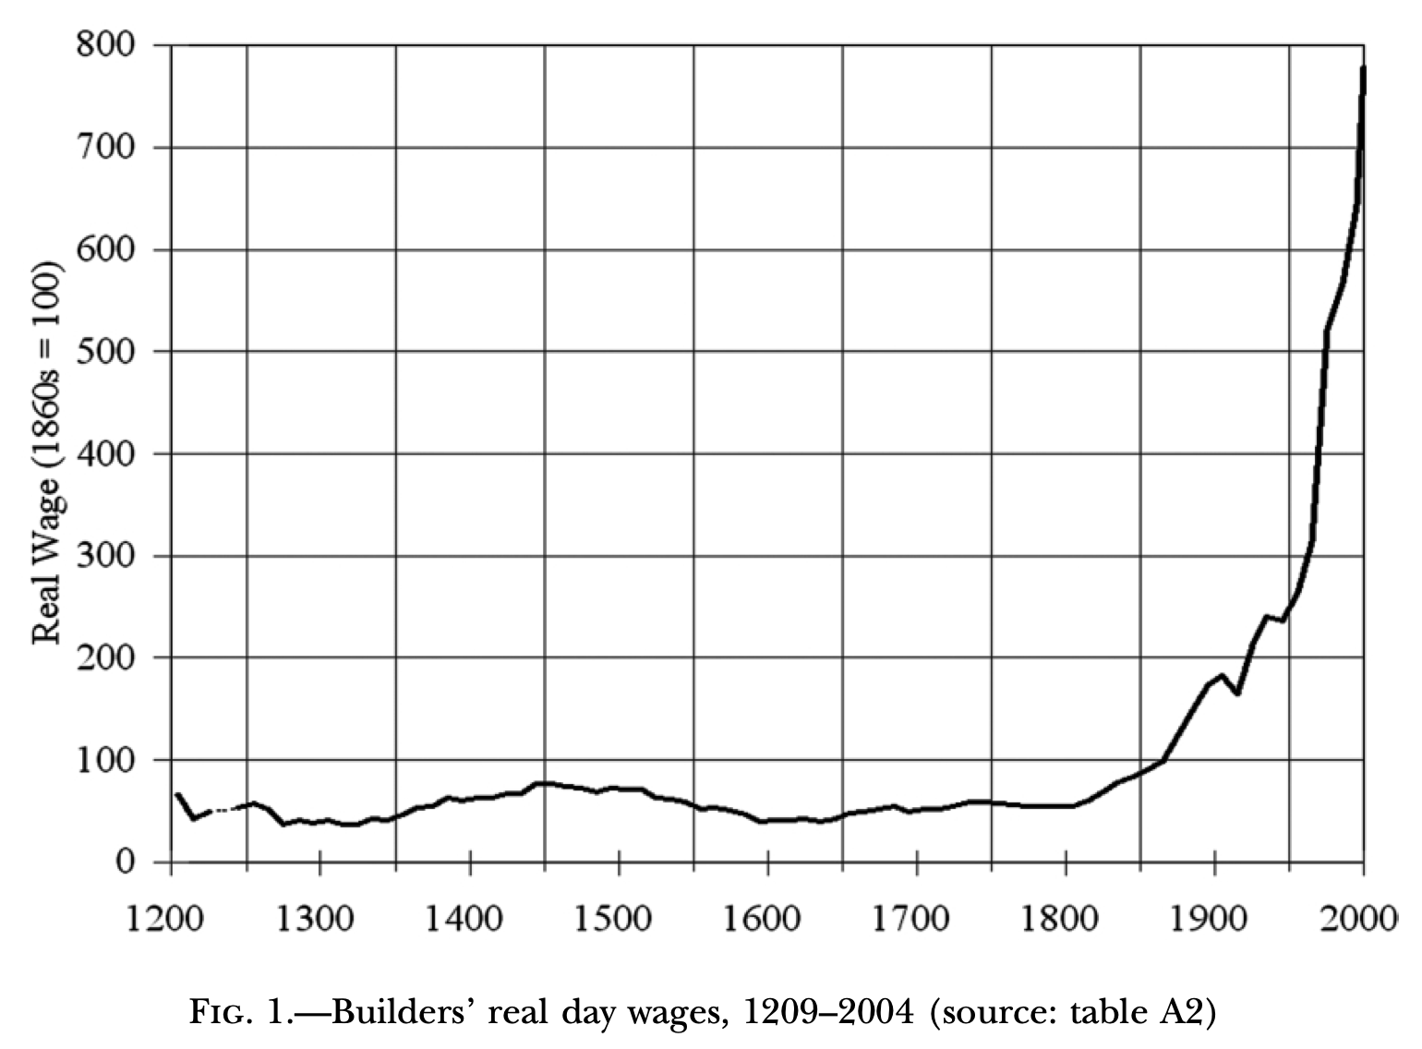
Module 1. Themes…
Orientation: Longest-run economic history: The Third Watershed
Video: Introduction: grand narrative & themes
Readings:
Long 20th Century Economic History: chs. 1 & 2
Prefatory notes on Diamond & Keynes
Reading 1: Jared Diamond (1999): The Worst Mistake in the History of the Human Race <https://github.com/braddelong/public-files/blob/master/readings/article-diamond-agriculture.pdf>
Reading 2: John Maynard Keynes (1931): Economic Possibilities for Our Grandchildren <https://github.com/braddelong/public-files/blob/master/readings/article-keynes-possibilities.pdf>
Discuss: Reaction to Readings for: 1. Themes…
Lectures & q & a:
Slides with Audio:
The Grand Narrative
Themes 4-6: Feminism, demography, inclusion
Themes 7-9: Tyrannies, wealth gulfs, mismanagement
Slouching Towards Utopia
Zoom Session: TBS (to be scheduled)
Problems & Interactions:
Do: PS01: The Three Watersheds
Discuss & present: Takeaways from & Extensions of: 1. Themes…
Addenda:
Text for Lectures on: 1. Themes…
Learning Goals for: 1. Themes…
Optional Further Readings…
Link
<https://github.com/braddelong/public-files/blob/master/econ-115-module-1-themes-%23tceh.pptx>
<https://www.icloud.com/keynote/02wUL2TNB-TpNnzfjl-8i_rwg>

Slide 2
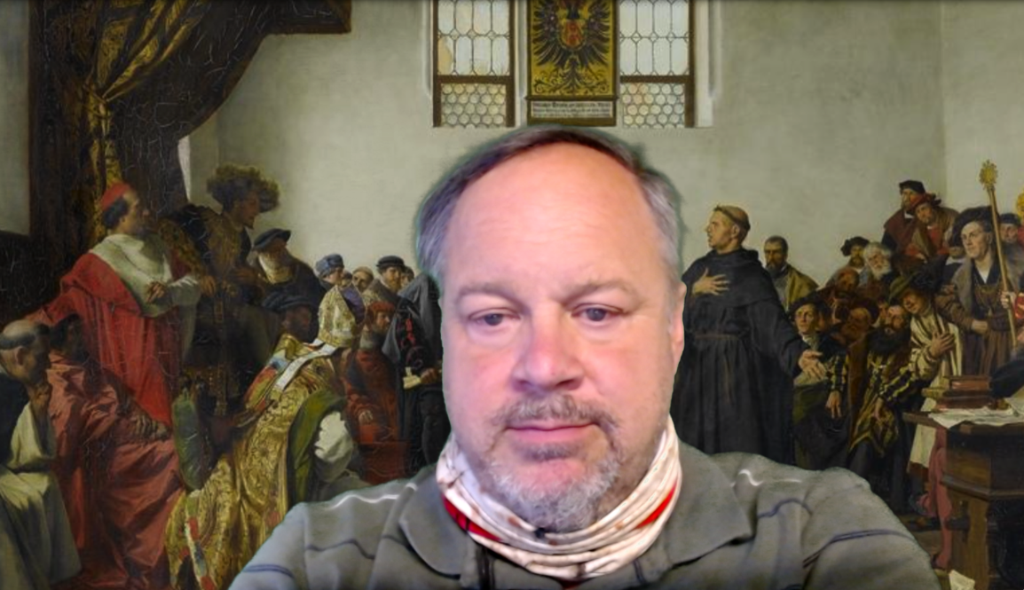
Introduction: Module 1.1. Themes Video
What are the big themes we are going to be dealing with in this course on the economic history of the long 20th century?
Big Ideas!: The idea behind taking any course is to build your human capital by making useful facts, patterns, and ways of thinking part of your own mental-intellectual panoply. And the key to doing that is to arranging them around “Big Ideas”. What are the Big Ideas—the major themes—of this course?
<https://youtu.be/pXRs2OLUhKo> <https://github.com/braddelong/public-files/blob/master/econ-115-module-1-1-themes-%23tceh.pptx>
6:50 of video
Notes:
Jump forward two- or three-thousand years from now. Then, in our future, history as _we_ know it will have been boiled down to its bare core. If there is somebody like me, working at a task something like this, informing students of the Big Ideas of a history course.
And then they will probably try to highlight a few Big Ideas about the history of the 20th century:
1. That the history of the twentieth century was overwhelmingly _economic_: the economy was the dominant arena of events and changes, and economic changes were the driving force behind other changes in a way never seen before in any century-long time span.
2. That the twentieth century saw the material wealth of humankind explode beyond all previous imagining: we—at least those of us who belong to the upper middle class and live in the industrial core of the world economy—are now far richer than the writers of previous centuries’ utopias could have imagined. Spearheaded in the American economy—“the furnace where the future was being forged”, in the words of communist Russian revolutionary Leon Trotsky—by the coming of the industrial research lab and the modern corporation to rationalize and routinize the process of inventing and diffusing technology; reinforced by globalization that interconnected everyone’s destiny with the destinies of billions of others thousands of miles away, the transformation of humanity from a state of general poverty to one in which there was enough wealth that, as my friend Max Singer used to say, a truly human world was within our grasp.
3. That alongside the coming of wealth was the coming of health and long life, and this had extraordinarily far-reaching ramifications: the escape from Malthusian poverty as the check on human fertility, the arrival of modern feminism and the decline—not fall—of patriarchy, the approach of zero population growth.
4. That a lot went wrong in the twentieth century. Its tyrannies were more brutal, bloody, & barbaric than in previous centuries. And—astonishingly—they had much of their origins in _economic_ discontents and _economic_ ideologies. People killed each other in large numbers over questions of how the economy should be organized. A declining significance of caste and ethnicity in hemming people into unfreedom was offset by a rising significance of parental wealth in restricting people via relative poverty to lives of relative drudgery and imprisonment. And governments, over and over again, failed to manage their economies to produce steady full employment, equitable growth, a sense of stability, and a sense that people received what they were owed and got what they deserved to get.
A word about the first of these—that the history of the 20th century was in a very important sense primarily _economic_. For most centuries, the core of history—the most interesting and important parts—was only tangentially at best related to the _economic_. For most centuries, the core of their history was, instead, intellectual or religious or political or cultural. The background behind me shows an 1877 interpretation of a moment that is at the core of the history of western Eurasia—what we usually call “Europe”—in the 1500s: the religious struggles of the Protestant Reformation and the Catholic Reformation. This moment is when the Holy Roman Emperor asks the monk and religious reformer Martin Luther to abandon some of his theological claims in order to maintain religious unity and concord among German Christians, and avoid bloody and brutal lengthy wars. Luther responds that his conscience will not let him. And Europe descends into nearly two centuries of near-genocidal religious war.
The consolidation of Christianity in the Roman Empire, the spread of Islam, the Protestant Reformation, the Italian Renaissance, Ming Dynasty artistic creations, the American and French Revolutions, the conquests of the _Devlet-i ʿAlīye-i ʿOsmānīye (what Britos called the Ottoman Empire) and the consolidation of the holdings of the Gurkani dynasty (what Britons called the Moghul Empire)—these are the things of which history principally consists. The economy the background against which the action of a play took place, for its changes were only visible in what Fernand Braudel called the _longue durée_—the long run.
Not so the history of the 20th century. The economy and economic events and changes are at its core.
And let me add a fifth Big Idea:
5. Our predecessors, many of them at least, would be amazed that, with the wealth and power, the technological and organizational tools, the knowledge and communications that we now possess, humanity has not done much more than it has done to make of the world a utopia. In the aftermath of World War I, Irish poet William Butler Yeats wrote of how positive utopian and millennial hopes seemed to be going wrong. The stories were that history was supposed to have a beautiful and miraculous end: a chosen one born in the city of King David—Bethlehem—to lead us all to a heavenly New Jerusalem.
But, Yeats wrote in his poem _The Second Coming_, it was not so.
It was not a chosen one but rather a “rough beast” “with lion body and the head of a man/a gaze blank and pitiless as the sun”. And its motion toward Bethlehem was a “slouching” one. Yeats’s poem has been called the “most pillaged” in modern times because it speaks to us. The history of the 20th century has seen us as a race are at best slouching, if that, towards something that might be a utopia, maybe.

Slide 3
Big Ideas of 20th Century History
History overwhelmingly economic…
Material wealth explodes beyond all previous imagining…
Health, long life, & their consequences—feminism…
That nevertheless a lot went wrong: tyranny, inequality, depression…
Notes:
1. That the history of the twentieth century was overwhelmingly _economic_: the economy was the dominant arena of events and changes, and economic changes were the driving force behind other changes in a way never seen before in any century-long time span.
2. That the twentieth century saw the material wealth of humankind explode beyond all previous imagining: we—at least those of us who belong to the upper middle class and live in the industrial core of the world economy—are now far richer than the writers of previous centuries’ utopias could have imagined. Spearheaded in the American economy—“the furnace where the future was being forged”, in the words of communist Russian revolutionary Leon Trotsky—by the coming of the industrial research lab and the modern corporation to rationalize and routinize the process of inventing and diffusing technology; reinforced by globalization that interconnected everyone’s destiny with the destinies of billions of others thousands of miles away, the transformation of humanity from a state of general poverty to one in which there was enough wealth that, as my friend Max Singer used to say, a truly human world was within our grasp.
3. That alongside the coming of wealth was the coming of health and long life, and this had extraordinarily far-reaching ramifications: the escape from Malthusian poverty as the check on human fertility, the arrival of modern feminism and the decline—not fall—of patriarchy, the approach of zero population growth.
4. That a lot went wrong in the twentieth century. Its tyrannies were more brutal, bloody, & barbaric than in previous centuries. And—astonishingly—they had much of their origins in _economic_ discontents and _economic_ ideologies. People killed each other in large numbers over questions of how the economy should be organized. A declining significance of caste and ethnicity in hemming people into unfreedom was offset by a rising significance of parental wealth in restricting people via relative poverty to lives of relative drudgery and imprisonment. And governments, over and over again, failed to manage their economies to produce steady full employment, equitable growth, a sense of stability, and a sense that people received what they were owed and got what they deserved to get.

Slide 4
A World About the First…
Before 1800 or so history not substantially economic…
Before 1870 or so history not primarily economic…
Back then, history was:
Religious or intellectual or political or cultural
Since 1870 history has been primarily economic…
Notes:
A word about the first of these—that the history of the 20th century was in a very important sense primarily _economic_. For most centuries, the core of history—the most interesting and important parts—was only tangentially at best related to the _economic_. For most centuries, the core of their history was, instead, intellectual or religious or political or cultural. The background behind me shows an 1877 interpretation of a moment that is at the core of the history of western Eurasia—what we usually call “Europe”—in the 1500s: the religious struggles of the Protestant Reformation and the Catholic Reformation. This moment is when the Holy Roman Emperor asks the monk and religious reformer Martin Luther to abandon some of his theological claims in order to maintain religious unity and concord among German Christians, and avoid bloody and brutal lengthy wars. Luther responds that his conscience will not let him. And Europe descends into nearly two centuries of near-genocidal religious war.
The consolidation of Christianity in the Roman Empire, the spread of Islam, the Protestant Reformation, the Italian Renaissance, Ming Dynasty artistic creations, the American and French Revolutions, the conquests of the _Devlet-i ʿAlīye-i ʿOsmānīye (what Britos called the Ottoman Empire) and the consolidation of the holdings of the Gurkani dynasty (what Britons called the Moghul Empire)—these are the things of which history principally consists. The economy the background against which the action of a play took place, for its changes were only visible in what Fernand Braudel called the _longue durée_—the long run.
Not so the history of the 20th century. The economy and economic events and changes are at its core.

Slide 5
A Fifth Big Idea
We are rich! Where is our utopia?
William Butler Yeats: The Second Coming:
Turning and turning in the widening gyre The falcon cannot hear the falconer; Things fall apart; the centre cannot hold; Mere anarchy is loosed upon the world….
Surely some revelation is at hand; Surely the Second Coming is at hand…. A shape with lion body and the head of a man, A gaze blank and pitiless as the sun… The darkness drops again; but now I know That twenty centuries of stony sleep Were vexed to nightmare by a rocking cradle, And what rough beast, its hour come round at last, Slouches towards Bethlehem to be born?
Notes:
And let me add a fifth Big Idea:
5. Our predecessors, many of them at least, would be amazed that, with the wealth and power, the technological and organizational tools, the knowledge and communications that we now possess, humanity has not done much more than it has done to make of the world a utopia. In the aftermath of World War I, Irish poet William Butler Yeats wrote of how positive utopian and millennial hopes seemed to be going wrong. The stories were that history was supposed to have a beautiful and miraculous end: a chosen one born in the city of King David—Bethlehem—to lead us all to a heavenly New Jerusalem.
But, Yeats wrote in his poem _The Second Coming_, it was not so.
It was not a chosen one but rather a “rough beast” “with lion body and the head of a man/a gaze blank and pitiless as the sun”. And its motion toward Bethlehem was a “slouching” one. Yeats’s poem has been called the “most pillaged” in modern times because it speaks to us.
The history of the 20th century has seen us as a race at best slouching, if that, towards something that might be a utopia, maybe.

Slide 6
Required Readings: Module 1.2. Prefatory Note for Required Reading: Diamond & Keynes
Jared Diamond started out as a medical teacher and researcher: he knew more than anybody else about how the membranes in the gall bladder worked. He then branched out to become an expert on the birds and the human ecology of New Guinea, and then branched out again to become an expert in global environmental and human history.
This piece we have asked you to read is a provocation: he does not really think the invention of agriculture was a mistake for him—he has not abandoned UCLA, moved to New Guinea, and taken up a career hunting and gathering. But he does believe, very strongly, that between the invention of agriculture 10,000 years ago and some time fairly recently, most humans have lived lives in which life was not only nasty, brutish, and short, but also that they would have been better off had they been born before 10000 years ago, back in the hunter-gatherer age. In the long agrarian age that followed the hunter-gatherer age, Diamond argues, there were many more people on the earth at any one time, but they lived less well.
As you read Diamond’s piece think about this: the piece is a provocation—it is not meant to be balanced. If Diamond had wanted to write a balanced piece, how would it have been different?
As the Great Depression of the 1930s fell across the globe, British economist John Maynard Keynes—then depressed because he thought and did know how to avoid the depression that was coming, but was not listened to—tried to distract himself by giving a talk about what he thought the human economy and human economic life (at least in the global north) would be like 100 years after 1930.
Well, here we are, not 100 years but 90 years after Keynes gave his talk and wrote it down.
You should note that we are now, at least in the global north, richer than Keynes thought we would be. Back then, all things told, average levels of income per capita in the global north were roughly equivalent to what we would think of as $5000/year—$15/day, taking everything. Keynes looked forward to growth at 1.5%/year thereafter, which would have carried the global north to average income of $20000 per year per capita today. In fact, we are at $50000: 2 1/2 times as wealthy as Keynes thought we would be.
So what did Keynes get wrong in his hopes about economic possibilities for our grandchildren (but not his: his Lydia Lopokova miscarried)? And what did Keynes get right?
Jared Diamond (1999): The Worst Mistake in the History of the Human Race <https://github.com/braddelong/public-files/blob/master/readings/article-diamond-agriculture.pdf>
John Maynard Keynes (1931): Economic Possibilities for Our Grandchildren <https://github.com/braddelong/public-files/blob/master/readings/article-keynes-possibilities.pdf>
——————————————————
Jared Diamond (301): Guns, Germs, & Steel: The Fates of Human Societies <>
John Maynard Keynes (1931): Keynes: Economic Possibilities for Our Grandchildren
Robert Skidelsky (2020): Keynes: A Very Short Introduction
Robert Skidelsky (2020): John Maynard Keynes
831 words

Slide 7
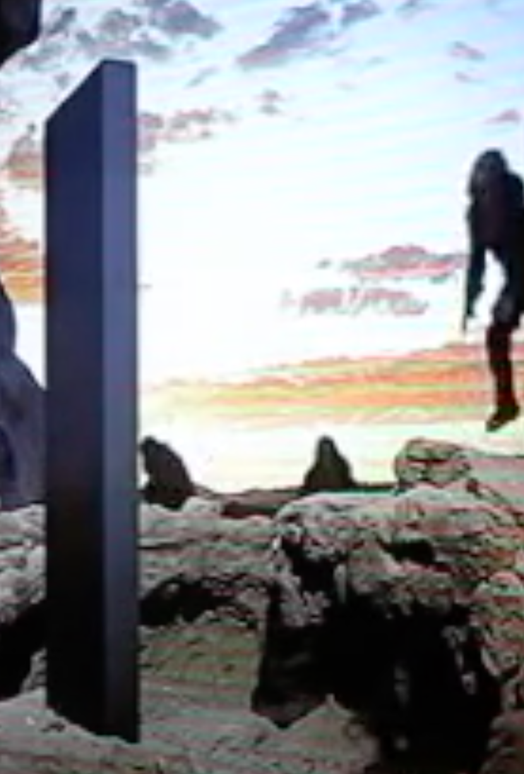
React to the Required Readings—Write & Discuss
Questions to answer, & then think about more deeply:
Diamond:
Were hunter-gatherers healthier or sicker than agricultural-age humans?
What evidence makes us rank the health of hunter-gatherers and agrarians the way we do?
Why did people choose to move into the agrarian mode of civilization, rather than remaining hunter-gatherers?
What does Jared Diamond assume that a good society consists of when he goes about analyzing whether the invention of agriculture was a “mistake”?
Keynes:
How rich did Keynes think humanity would be in 2030, a century after he wrote his essay?
How rich did Keynes think humanity had to become before increasing one’s material wealth would cease to be thought of as an important thing at all?
What did Keynes think people in the middle of the century of the 2000s would probably focus their energy on?
What reasons did Keynes give for expecting the advance in human material wealth and well being that he expected?
Let me start this discussion off by asking four questions:
Which themes of this course are pedagogically excessive—give you too much to learn and remember, hence learn and remember it less well?
What that is not a theme of this course should be? What is missing from the story that DeLong wants to tell?
What aspects of civilization—today and in the past—would you focus on if you wanted to write a counterblast to Diamond’s pessimism?
What aspects of civilization—today and in the past—would you focus on if you wanted to write a counterblast to Keynes’s optimism?
As before, for full credit for this discussion, provide at least two substantive contributions to the discussion, of which at most one should be a direct response to one of my questions. We want you to talk to & react to one another here…
THREADED DISCUSSION URL: <https://bcourses.berkeley.edu/courses/1493152/discussion_topics/5774300>
184 words

Slide 8

Lectures, Slides, & Q&A: Module 1.3
Lecture slides with audio:
Grand growth narrative
Inequality & humanity
What has gone badly wrong
Slouching towards utopia?
Zoom Q&A session:
TBS (to be scheduled)
Optional lecture slides:
Link
Link

Slide 9
1.3. Lecture slides with audio
Grand growth narrative
<https://github.com/braddelong/public-files/blob/master/econ-115-module-0-lecture-1-activities-%23tceh.pptx> 7:45 slides with audio
Inequality & humanity
<https://github.com/braddelong/public-files/blob/master/econ-115-module-0-lecture-2-education-process-%23tceh.pptx> 9:30 slides with audio
What has gone badly wrong
<https://github.com/braddelong/public-files/blob/master/econ-115-module-0-lecture-3-dasguptas-takes-%23tceh.pptx> 6:15 slides with audio
Slouching towards utopia?
<https://github.com/braddelong/public-files/blob/master/econ-115-module-0-lecture-4-logistics-%23tceh.pptx>
Link
Link

Slide 10
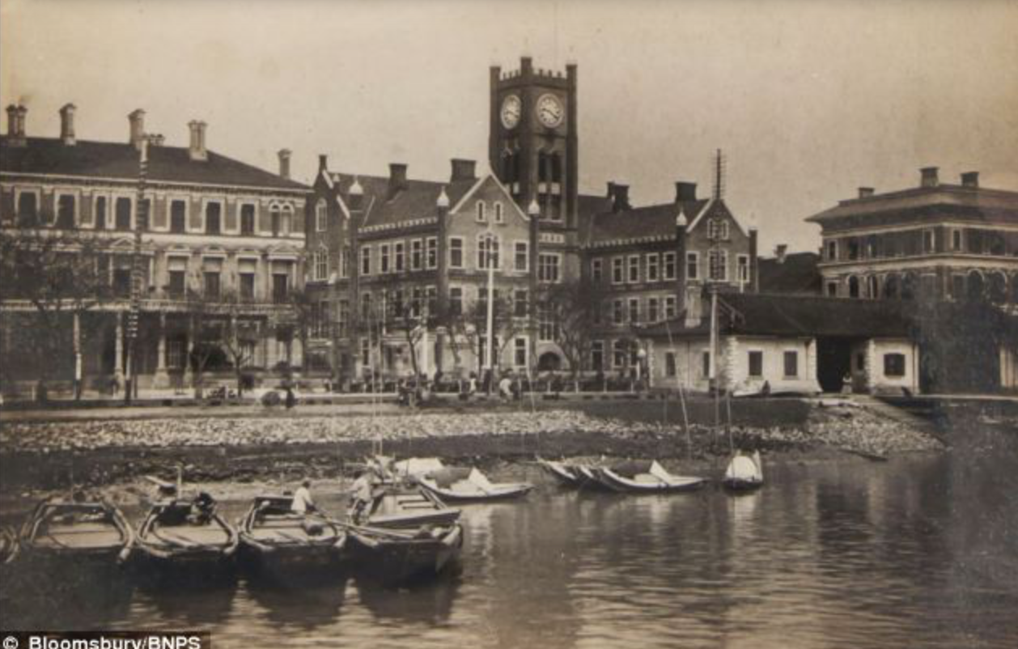
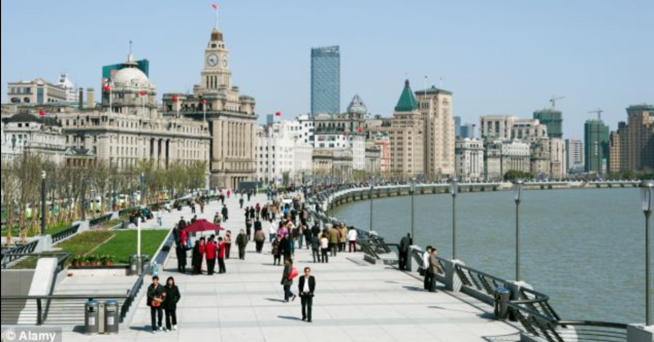
Lecture: 1.3.1. Grand Narrative
Five lecture components:
The Grand Narrative
Themes 1-3: History economic, wealth explosion, technological cornucopia
Themes 4-6: Feminism, demography, inclusion
Themes 7-9: Tyrannies, wealth gulfs, mismanagement
Slouching Towards Utopia?
Orienting yourself:
When do I say the Long 20th Century really started?
Why then?
When do I say the Long 20th Century really ended?
Why then?
What was the typical human standard of living back in 1870?
What is the typical human standard of living today?
Is there a typical human standard of living today?
Is the world today a utopia?
Is greater San Francisco today a utopia?
3:00 of audio in this slide; 9:30 in this slide group
Notes:
Good morning, good afternoon, or good evening. I’m Brad DeLong. And this is my economic history of the long twentieth century.
At the top on the right hand of this slide we have the real—that is, inflation and deflation adjusted so that we do not get confused by changes in the purchasing power of money—wages of people working in the construction trades in England from 1200 to the present. This real wage series has a somewhat shaky basis. We know how much in money terms construction workers were paid. We know how much in money terms the things they bought cost. We do not know as much as we would like about how long the working day was. And we are pretty much at sea when it comes to the question of how we incorporate into our index the fact that people today can buy many, many, many more and different useful things than people could buy back in 1300. This graph almost surely makes the upward pointing blade of the hockey stick at the right hand side of the figure a lot smaller then a properly representative graph would show.
In the middle of the right hand side of the slide we have a picture of the Shanghai waterfront in I think it is the 1880s: a view of the den British concession. At the bottom we have the Shanghai waterfront earlier in this decade. Quite a difference, no? The contrast between these two pictures is the on the ground reality that corresponds to the different height of the line on the graph in the 1800s and today. By contrast with all previous human civilizations, our knowledge of technology and of human organization makes us rich beyond even the imaginings of the fables that people told in the past.
And the bulk of the transformation from the poor, largely subsistence human world of the past to our prosperous – potentially prosperous, at least – world of today was accomplished in the long 20th century from 1870 to 2016.
That explosion of human wealth driven forward by the extraordinary advance of knowledge in how to use technologies to manipulate the matter and energy of nature, and to organize humans productively, is the core of my Grand Narrative of the economic history of the long 20th century.
In telling this granddaughters we will find ourselves visiting and revisiting nine different themes. Three of these themes will focus on engineering and economics in the forms of technology, accumulation, and production; three will focus on sociology and economics in the forms of gender, ethnicity, and social roles; and three will focus on politics and economies in the forms of tyranny, property control, and economic system governance and mismanagement. And then there is the question of how we assess this historical process. If we frame things by supposing that the people who inhabited the world in the long 20th century had the historical task of carrying the baton toward utopia, how well did they do?
By now you should have read at least the first two chapters of my manuscript on the economic history of the long 20th century. But if you read it passively, I want you to go back and do it again, this time reading it actively. How do you know if you read it passively? If you cannot answer the questions underneath the “orienting yourself” heading on the left side of the slide, go back and read it again—this time asking yourself questions as you read, and answering them, and also asking me questions, and imagining in your mind’s eye and ear what my answers would be.

Slide 11
Orientation
Chronology:
When do I say the Long 20th Century really started? 1870
Why then? The third watershed—the third step-up in the global pace of economic growth—globalization, and the start of the American century
When do I say the Long 20th Century really ended? 2016.
Why then? Three reasons: (1) end of the American century, slowdown in global north growth, failure of economic management.
Quantities:
What was the typical human standard of living back in 1870? Perhaps $4/day—$1300/year
What is the typical human standard of living today? Perhaps $35/day—$12000/year
Is there a typical human standard of living today? Maybe not: inequality is much greater than it was in 1870, and even more so in 1800. A global north of 800 million with a typical standard of living of $50000/year—$150/day; a global south of 6.8 billion with a typical standard of living of $7000/year—$20/day
Is the world today a utopia? Definitely not…
Is greater San Francisco today a utopia? What do you think?
3:00 of audio in this slide
Notes:
Well, you don’t have to rely purely on your imaginings in order to figure out what my answers to the orienting questions are. I am right here. Here are the questions, and my answers.
When do I say the Long 20th Century really started? 1870.
Why then? The third watershed—the third step-up in the global pace of economic growth—globalization, and the start of the American century.
When do I say the Long 20th Century really ended? 2016.
Why then? Three reasons: (1) end of the American century, (2) slowdown in global north growth, (3) failures of economic management.
What was the typical human standard of living back in 1870? Perhaps $4/day—$1300/year
What is the typical human standard of living today? Perhaps $35/day—$12000/year
Is there a typical human standard of living today? Maybe not: inequality is much greater than it was in 1870, and even more so in 1800. A global north of 800 million with a typical standard of living of $50000/year—$150/day; a global south of 6.8 billion with a typical standard of living of $7000/year—$20/day
Is the world today a utopia? Definitely not…
Is greater San Francisco today a utopia? What do you think?
Do you think my answers are right? Or, rather: which of my answers do you think are wrong, and why do you think so?

Slide 12
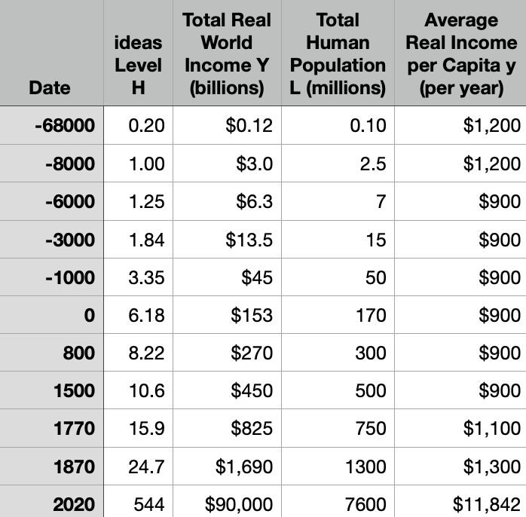
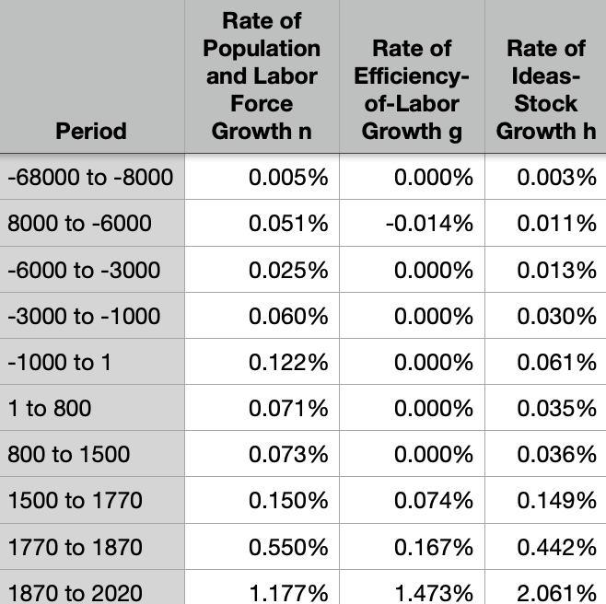
Knowledge & Resources
Why pre-1870 poverty?:
Overwhelmingly: Malthusian factors
Population outran means of subsistence produced by limited resources & slowly-growing technological knowledge
Why was technological knowledge slowly growing?
Few heads?
Entrepreneurship directed toward exploitation?
Absence of routinization?
The industrial research lab and the modern corporation
Quantities:
Probable fall in living standards with the coming of the agrarian age
Typical agrarian age rate of ideas growth of 0.035%/year
Watershed 1: the 1500 commercial revolution—quadrupling of ideas growth to 0.15%/year
Watershed 2: the 1770 industrial revolution—tripling of ideas growth to 0.44%/year
Watershed 3: the 1870 coming of modern economic growth—near-quintupling of ideas growth to 2.1%/year
Only the last banishes the Malthusian Devil…
3:00 of audio in this slide
Notes:
Why pre-1870 poverty?:
Overwhelmingly: Malthusian factors
Population outran means of subsistence produced by limited resources & slowly-growing technological knowledge
Why was technological knowledge slowly growing?
Few heads?
Entrepreneurship directed toward exploitation?
Absence of routinization?
The industrial research lab and the modern corporation
Quantities:
Probable fall in living standards with the coming of the agrarian age
Typical agrarian age rate of ideas growth of 0.035%/year
Watershed 1: the 1500 commercial revolution—quadrupling of ideas growth to 0.15%/year
Watershed 2: the 1770 industrial revolution—tripling of ideas growth to 0.44%/year
Watershed 3: the 1870 coming of modern economic growth—near-quintupling of ideas growth to 2.1%/year
Only the last banishes the Malthusian Devil…

Slide 13
Pre-Industrial Poverty
The principal reason that pre-industrial humanity was so poor was:
Because people back then were genetically cognitively inferior to us.
Because people back then were malnourished, and so cognitively inferior to us.
Because of Malthusian reasons.
Because of oppressive upper classes.
Something different from the above
Notes:
The principal reason that pre-industrial humanity was so poor was:
Because people back then were genetically cognitively inferior to us.
Because people back then were malnourished, and so cognitively inferior to us.
Because of Malthusian reasons.
Because of oppressive upper classes.
Something different from the above

Slide 14
Why Wasn’t the World Richer in 1870?
There was substantial technological progress between the end of agrarian stagnation in 1500 and 1870. So why wa the world in 1870 still so poor—with most humans having good reason to fear that it might be difficult to get their 2000 calories a day next year, and many had good reason to fear that it might be difficult to get their 2000 calories a day next week?
Because of rapidly rising inequality: the coming of the modern state with its police and its army allowed the rich to hold on to massive amounts of property.
Because of capitalism: capitalists still the property of the farmers and the craftsmen and turned them into wage-slaves.
Because of Malthusian pressures: population growth meant that average farm sizes in 1870 were but 2/5 of what they had been in 1500.
The premise is false: the typical human in 1870 had roughly four times the standard of living of the typical human in 1500.
Something different.
Notes:
There was substantial technological progress between the end of agrarian stagnation in 1500 and 1870. So why wa the world in 1870 still so poor—with most humans having good reason to fear that it might be difficult to get their 2000 calories a day next year, and many had good reason to fear that it might be difficult to get their 2000 calories a day next week?
Because of rapidly rising inequality: the coming of the modern state with its police and its army allowed the rich to hold on to massive amounts of property.
Because of capitalism: capitalists still the property of the farmers and the craftsmen and turned them into wage-slaves.
Because of Malthusian pressures: population growth meant that average farm sizes in 1870 were but 2/5 of what they had been in 1500.
The premise is false: the typical human in 1870 had roughly four times the standard of living of the typical human in 1500.
Something different.

Slide 15
The Long 20th Century’s Economic Revolution
Its principal source was:
The existence of a market economy: rapid modern economic growth is inevitable once you have a stable market economy with secure property rights.
The cheap ocean and rail transport that destroyed distance as a cost and brought economies all over the world cheek-by-jowl: this greatly amplified the division of labor, and prosperity depends primarily on a fine division of labor.
The transformation and routinization of invention, via the creation of the industrial research labs to develop and the communities of engineering practice to understand and the corporations to deploy—these were the things that supercharged economic growth
The ability to greatly ramp up the rate of exploitation, and so devote much more of society’s production to investment and capital accumulation.
None of the above.
Notes:
Its principal source was:
The existence of a market economy: rapid modern economic growth is inevitable once you have a stable market economy with secure property rights.
The cheap ocean and rail transport that destroyed distance as a cost and brought economies all over the world cheek-by-jowl: this greatly amplified the division of labor, and prosperity depends primarily on a fine division of labor.
The transformation and routinization of invention, via the creation of the industrial research labs to develop and the communities of engineering practice to understand and the corporations to deploy—these were the things that supercharged economic growth
The ability to greatly ramp up the rate of exploitation, and so devote much more of society’s production to investment and capital accumulation.
None of the above.

Slide 16
What Is the Average Global Rate of Economic Growth per Capita over the Long 20th Century?
What is the single number you should hold in your head?
0.15% per year
1.5% per year.
8% per year.
2.1% per year
None of the above.
Notes:
What is the single number you should hold in your head?
0.15% per year
1.5% per year.
8% per year.
2.1% per year
None of the above.

Slide 17
Shadows…
How many people today are still living on less than $2 a day?
70 million
230 million
700 million
2.3 billion
None of the above.
Notes:
How many people today are still living on less than $2 a day?
70 million
230 million
700 million
2.3 billion
None of the above.

Slide 18

Lecture: 1.3.2. Inequality & Humanity
Feminism, demography, inclusion
Bellamy’s Looking Backward:: The elimination of housework, and of a servant class:
‘“Who does your house-work, then?” I asked.
‘“There is none to do,” said Mrs. Leete.… “Our washing is all done at public laundries at excessively cheap rates, and our cooking at public kitchens. The making and repairing of all we wear are done outside in public shops. Electricity, of course, takes the place of all fires and lighting. We choose houses no larger than we need, and furnish them so as to involve the minimum of trouble to keep them in order. We have no use for domestic servants….
‘“What a paradise for womankind the world must be now!” I exclaimed. “In my day, even wealth and unlimited servants did not enfranchise their possessors from household cares, while the women of the merely well-to-do and poorer classes lived and died martyrs to them…”’
What has happened to patriarchy since 1870?
What has happened to gender roles in production and consumption since 1870?
What has happened to demography since 1870?
3:00 of audio in this slide
Notes:
Machiavelli, as portrayed by himself, and Sokrates, as portrayed by Plato, have diametrically opposed views of the usefulness of books. For Machiavelli, a book is almost as good as being there with the author—indeed, books are better, because Machiavelli in his library has many authors, all at his beck and call. Sokrates, by contrast, appears to think that books are very likely to be misread and misinterpreted: “they cannot defend themselves", "they do not know to whom they should reply, to whom not”.
For Sokrates, real education is only conducted by a teacher skilled in the art of dialectic—of getting a true dialogue going that leads the student to think for themself and thus have planted in their brain “words which are able to help themselves”, which will then “make the possessors… happy to the utmost extent of human happiness”.
Machiavelli, by contrast, thinks that education is accomplished by simply throwing somebody with leisure to read into a library.
For most people almost all of the time, for some people most of the time, and for all people at least some of the time, Sokrates was right: it is hard work to learn anything but the most partial and evanescent knowledge from books. That was the point of the Andy Matuschak reading—and I hope you got that point, although right now I am wondering if starting this course by asking you to learn something by reading an article was a smart thing for me to have done.
Andy Matuschak has ideas about how to reorganize and restructure books to make reading easier, or at least better from an educational point of view. And—his complaints about university courses that consist of badly taught lectures aside—I think it is fruitful to think of universities-as-institutions as scaffoldings and support systems to make deep and durable learning from books and other media easy, or easier, or at least possible: although you cannot lead a horse to water, you cannot make them drink if they do not want to.
We now face the problem of reproducing what makes a university work—what makes students at a well-functioning university more like Machiavellis and less like the hapless students of Sokrates, who are able to learn only through the deep, focused, personal attention of one of the greatest minds known to us in human history.
How are we going to manage to accomplish this?
——
Lecture: Sokrates vs. Machiavelli on the Educational Process
Machiavelli:
I… put on the garments of court and palace… step inside the venerable courts of the ancients, where, solicitously received by them, I nourish myself on that food that alone is mine and for which I was born; where I am unashamed to converse with them and to question them about the motives for their actions, and they, out of their human kindness, answer me. And for four hours at a time I feel no boredom, I forget all my troubles, I do not dread poverty, and I am not terrified by death…
Sokrates:
The creations of the painter have the attitude of life, and yet if you ask them a question they preserve a solemn silence…. [Words] once written down they are tumbled about anywhere among those who may or may not understand them, and know not to whom they should reply, to whom not… and they cannot protect or defend themselves…. Would a husbandman… take the seeds… and in sober seriousness plant them during the heat of summer?… The serious pursuit of the dialectician… finding a congenial soul, by the help of science sows and plants therein words which are able to help themselves… and have in them a seed which others brought up in different soils render immortal, making the possessors of it happy to the utmost extent of human happiness…

Slide 19
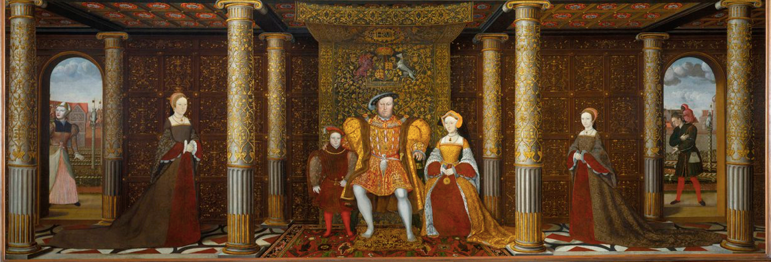
Childbed: British Queens
16 generations from Henry IV to Victoria
5 queens (or heiresses apparent) dead in childbed: Charlotte (Victoria’s generation), Catherine Parr, Jane Seymour, Elizabeth of York, Mary de Bohun
At an average of two queens per generation, this is a 16% childbed mortality rate for the most cosseted women in England
2% maternal mortality per birth
1% extra mortality from nursing sick children

Slide 20
Demographic Transition
Agrarian Age:
8.5 pregnancies
6 live births
3.5 survive to age 5
2.5 survive to adulthood
2 reproduce in their turn
How many years eating for two?
Pregnant: 8 x 9 mo = 6 years
Nursing: 2 x 6 = 12 years
Total: 18 years
Why?
Birth control technology not well-developed
Need to have surviving descendants as the only form of social insurance
Being a mother as a form of social power
Modern Age:
2.5 pregnancies
2.0 live births
1.98 survive to age 5
1.96 survive to adulthood
1.75 reproduce in their turn
How many years eating for two?
Pregnant: 2.2 x 9 mo = 1 2/3 years
Nursing: 1 1/6 x 2 = 2 1/3 years
Total: 4 years

Slide 21
Women in Their Place…
Biology…
16% childbed mortality; 8% excess nursing sick mortality…
3 yr x 7? 20 years eating for two?
Occupations…
(Elizabeth Wayland Barber (1995): Women's Work: The First 20,000 Years Women, Cloth, and Society in Early Times (0393035069) <http://amzn.to/2BSw3fZ>
Patriarchy…
Societal expectations…
Interactions
Disparate impact
Even in Denmark today:
7% lower employment probability
7% lower hours per week conditional on employment
7% lower wages and salaries conditional on employment and hours…

Slide 22
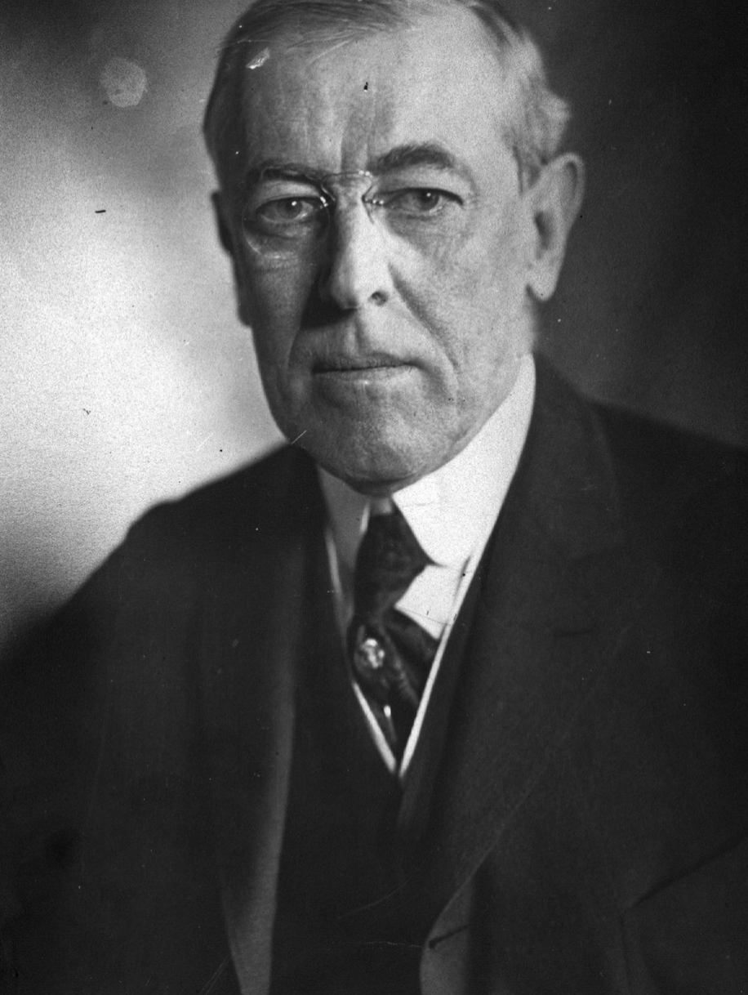
Racial Hierarchies
Woodrow Wilson:
A great change in the character of immigration which our newly industrialized country began now to attract from abroad. Down to 1880 the vast proportion of immigrants to this country were from the easily assimilable stock of western Europe, who, upon their arrival here, largely sought the land…. There is no longer any land to seek, and even if there were, the poverty-stricken Italians, Hebrews, and Slavs, who in 1905 made up three fifths of the immigrant arrivals to these shores, are neither disposed nor able to make their way to it.
The general questions raised by the new type of immigration on a large scale were first raised, and in an exceptionally acute form, by Chinese immigration. Chinese began coming to this country in considerable numbers about the close of the Civil War and were of the greatest possible service in completing the great transcontinental railways. The Treaty of Washington with China in 1868 was therefore giving voice to no mere banality in recognizing the mutual advantage of this migration. But it was also this very fact of the completion of the Pacific roads that brought about a great reversal of feeling with regard to the Chinese, who now began to make their way eastward, where their abhorrent social arrangements and filthy habits of living made them local nuisances….
In 1879 Congress passed a resolution ordering the President to declare the Treaty of 1868 null and void…. The Angell Treaty of 1880, according the United States permission to "regulate, limit, or suspend" the immigration of Chinese laborers. The bill passed by Congress early in 1882 " suspended " such immigration for twenty years, but a presidential veto brought about a reduction of this term to ten years in the measure that was finally enacted.
The same year, its attention being now upon the immigrant problem, Congress decreed the exclusion of paupers, criminals, convicts, and insane persons, and imposed a poll tax of fifty cents…. By the Act of 1890 polygamists, diseased persons, and persons incapable of self-support, were excluded. By the Geary Act of 1892 and an Act of 1902 Chinese exclusion was renewed and made more stringent… By the Act of 1903 the capitation tax upon immigrants was raised to two dollars…

Slide 23
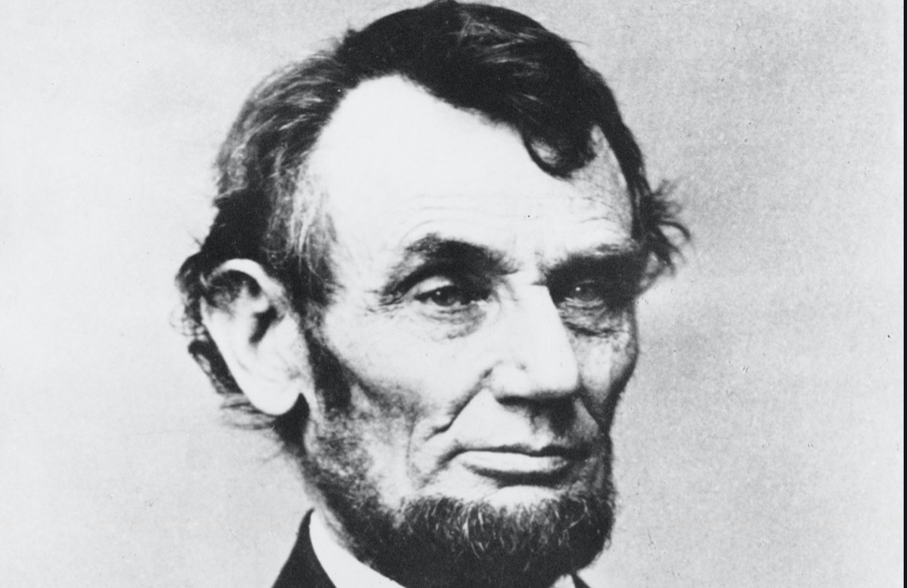
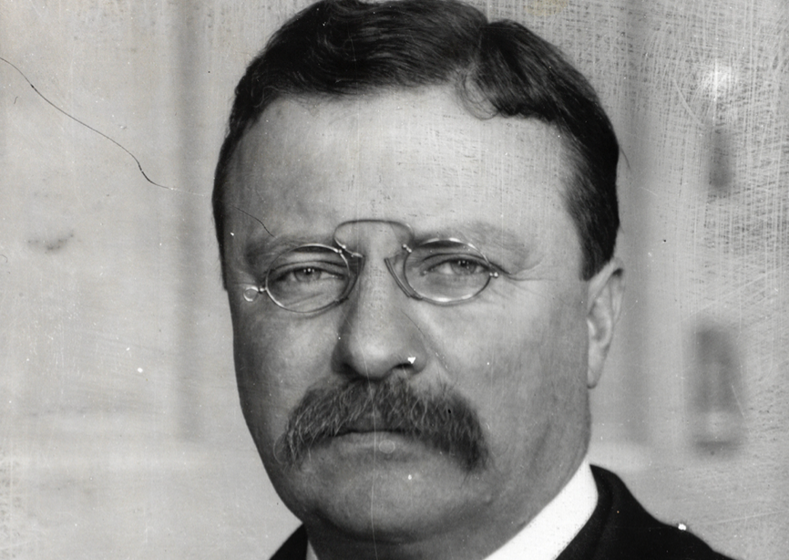
But See Also…
Abraham Lincoln:
There is no reason in the world why the negro is not entitled to all the rights enumerated in the Declaration of Independence-the right of life, liberty, and the pursuit of happiness. I hold that he is as much entitled to these as the white man. I agree with Judge Douglas that he is not my equal in many respects, certainly not in color-perhaps not in intellectual and moral endowments; but in the right to eat the bread without the leave of any body else which his own hand earns, he is my equal and the equal of Judge Douglas, and the equal of every other man…
Theodore Roosevelt:
There is nothing easier than to belittle the great men of the past by dwelling only on the points where they come short of the universally recognized standards of the present. .Men must be judged with reference to the age in which they dwell, and the work they have to do.... We have traveled far since [the Puritan's] day. That liberty of conscience which he demanded for himself, we now realize must be as freely accorded to others as it is resolutely insisted upon for ourselves.
The splendid qualities which he left to his children, we other Americans who are not of Puritan blood also claim as our heritage. You, sons of the Puritans; and we, who are descended from races whom the Puritans would have deemed alien—we are all Americans together. We all feel the same pride in the genesis, in the history, of our people; and therefore this shrine of Puritanism is one at which we all gather to pay homage, no matter from what country our ancestors sprang.
We have gained some things that the Puritan had not—we of this generation, we of the twentieth century, here in this great Republic; but we are also in danger of losing certain things which the Puritan had and which we can by no manner of means afford to lose..

Slide 24
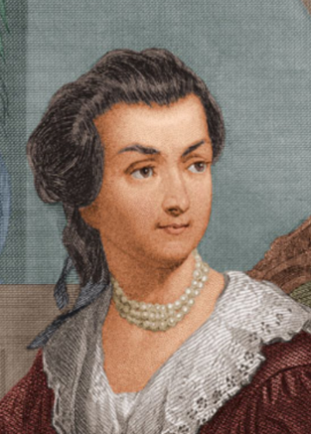
Abigail Smith and John Adams
Abigail Smith (20) married John Adams (30) in 1764:
Children:
Abigail ("Nabby") 1765–1813
John Quincy Adams 1767–1848
Grace Susanna ("Suky") 1768–70
Charles 1770–1800
Thomas Boylston Adams 1772–1832
Elizabeth (stillborn) 1777
Then they stopped…
She ran his Braintree-Boston operation…
“I desire you would Remember the Ladies, and be more generous and favourable to them than your ancestors. Do not put such unlimited power into the hands of the Husbands…. That your Sex are Naturally Tyrannical is a Truth so thoroughly established as to admit of no dispute, but such of you as wish to be happy willingly give up the harsh title of Master for the more tender and endearing one of Friend. Why then, not put it out of the power of the vicious and the Lawless to use us with cruelty and indignity with impunity?
“Men of Sense in all Ages abhor those customs which treat us only as the vassals of your Sex. Regard us then as Beings placed by providence under your protection and in immitation of the Supreem Being make use of that power only for our happiness…”

Slide 25
Abigail Smith Adams: Virginia/Boston
Letter to John Adams 31 Mar-5 Apr 1776: <https://tinyurl.com/dl20180226a>…
I wish you would ever write me a Letter half as long as I write you…. Where your Fleet are gone? What sort of Defence Virginia can make?… Are not the Gentery Lords and the common people vassals?… I hope their Riffel Men who have shewen themselves very savage and even Blood thirsty; are not a specimen of the Generality of the people.…
I have sometimes been ready to think that the passion for Liberty cannot be Eaquelly Strong in the Breasts of those who have been accustomed to deprive their fellow Creatures of theirs. Of this I am certain that it is not founded upon that generous and christian principal of doing to others as we would that others should do unto us….
Do not you want to see Boston? I am fearfull of the small pox, or I should have been in before this time…. I got Mr. Crane to go to our House and see what state it was in. I find it has been occupied by one of the Doctors of a Regiment, very dirty, but no other damage has been done to it. The few things which were left in it are all gone. Cranch has the key which he never deliverd up. I have wrote to him for it and am determined to get it cleand as soon as possible and shut it up. I look upon it a new acquisition of property, a property which one month ago I did not value at a single Shilling, and could with pleasure have seen it in flames….
You inquire of whether I am making Salt peter. I have not yet attempted it, but after Soap making believe I shall make the experiment. I find as much as I can do to manufacture cloathing for my family which would else be Naked. I know of but one person in this part of the Town who has made any, that is Mr. Tertias Bass as he is calld who has got very near an hundred weight which has been found to be very good….
April 5: Not having an opportunity of sending this I shall add a few lines more; tho not with a heart so gay. I have been attending the sick chamber of our Neighbour Trot whose affliction I most sensibly feel but cannot discribe, striped of two lovely children in one week. Gorge the Eldest died on wedensday and Billy the youngest on fryday, with the Canker fever, a terible disorder so much like the throat distemper, that it differs but little from it. Betsy Cranch has been very bad, but upon the recovery. Becky Peck they do not expect will live out the day. Many grown persons are now sick with it, in this street. It rages much in other Towns. The Mumps too are very frequent. Isaac is now confined with it. Our own little flock are yet well. My Heart trembles with anxiety for them. God preserve them.

Slide 26
John Adams’s Reply to Abigail
As to your extraordinary code of laws, I cannot but laugh.
We have been told that our struggle has loosened the bonds of government everywhere; that children and apprentices were disobedient; that schools and colleges were grown turbulent; that Indians slighted their guardians, and negroes grew insolent to their masters.
But your letter was the first intimation that another tribe, more numerous and powerful than all the rest, were grown discontented.
This is rather too coarse a compliment, but you are so saucy, I won't blot it out.
Depend upon it, we know better than to repeal our masculine systems. Although they are in full force, you know they are little more than theory. We dare not exert our power in its full latitude. We are obliged to go fair and softly, and, in practice, you know we are the subjects.
We have only the name of masters, and rather than give up this, which would completely subject us to the despotism of the petticoat, I hope General Washington and all our brave heroes would fight.

Slide 27
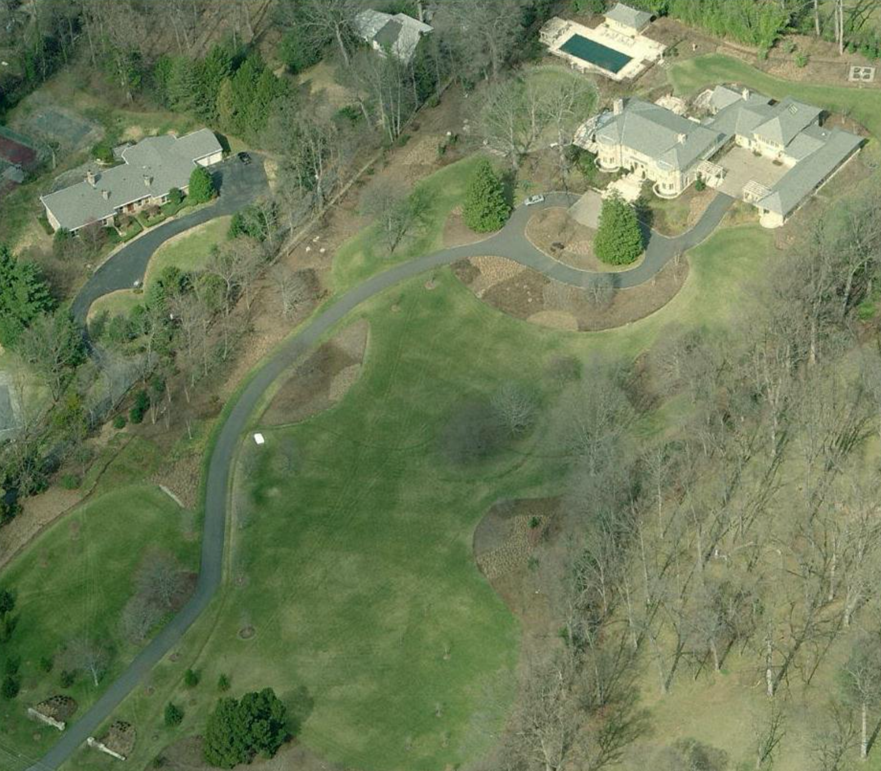
Lecture: 1.3.3. What Has Gone Badly Wrong
Tyrannies, wealth gulfs, mismanagement:
Hitler, Stalin, Mao—and their little brothers. Enough said…
Well, maybe not enough said: the peculiar thing was that (most of?) these tyrannies were powered by ideas about economic organization
Wealth gulfs of a magnitude previously unbelievable
Pre-1870 societies simply were not rich enough formodern second gilded age degrees of wealth inequality to be possible
Failures of management
Mass unemployment
Karl Polanyi’s insights:
The market economy recognizes only property rights
But people think they have rights to land, labor, and finance
Land: a stable community, and an absence of negative externalities
Labor: a right to a stable income commensurate with what one deserves (and to appropriate income and status differentials: unequals should be treated unequally)
Finance: that the stability of one’s job and one’s business not depend on incomprehensible decisions of financiers thousands of miles away
The Friedmans bought a seven-and-a-half-acre lot in Bethesda, Maryland. They tore down the existing house, built an eleven-thousand-square-foot replacement, and planted two hundred trees. (In a note at the end of “Hot, Flat, and Crowded,” where Friedman explains his own ecological circumstances—geothermal heating, solar panels—he invites readers, perhaps unwisely, to regard his real-estate move as an act of rescue: he writes that he and his wife bought the land “to prevent it from being redeveloped into a subdivision of a dozen or more houses,” which could sound like someone buying a lot of champagne to protect society from corkrelated injuries.)… “Honestly, I still can’t wait to get my pants on in the morning,” Friedman said…. On weekdays, he’ll head into D.C. for a seven-thirty breakfast meeting…
3:00 of audio in this slide
Notes:
Tyrannies, wealth gulfs, mismanagement:
Hitler, Stalin, Mao—and their little brothers. Enough said…
Well, maybe not enough said: the peculiar thing was that (most of?) these tyrannies were powered by ideas about economic organization
Wealth gulfs of a magnitude previously unbelievable
Pre-1870 societies simply were not rich enough formodern second gilded age degrees of wealth inequality to be possible
Failures of management
Mass unemployment
Karl Polanyi’s insights:
The market economy recognizes only property rights
But people think they have rights to land, labor, and finance
Land: a stable community, and an absence of negative externalities
Labor: a right to a stable income commensurate with what one deserves (and to appropriate income and status differentials: unequals should be treated unequally)
Finance: that the stability of one’s job and one’s business not depend on incomprehensible decisions of financiers thousands of miles away

Slide 28
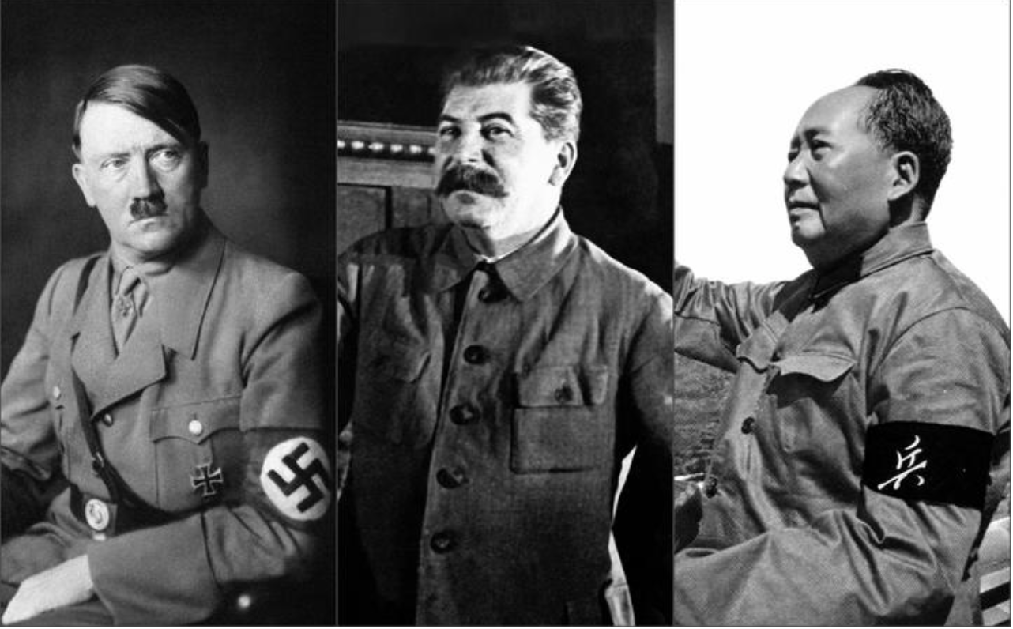
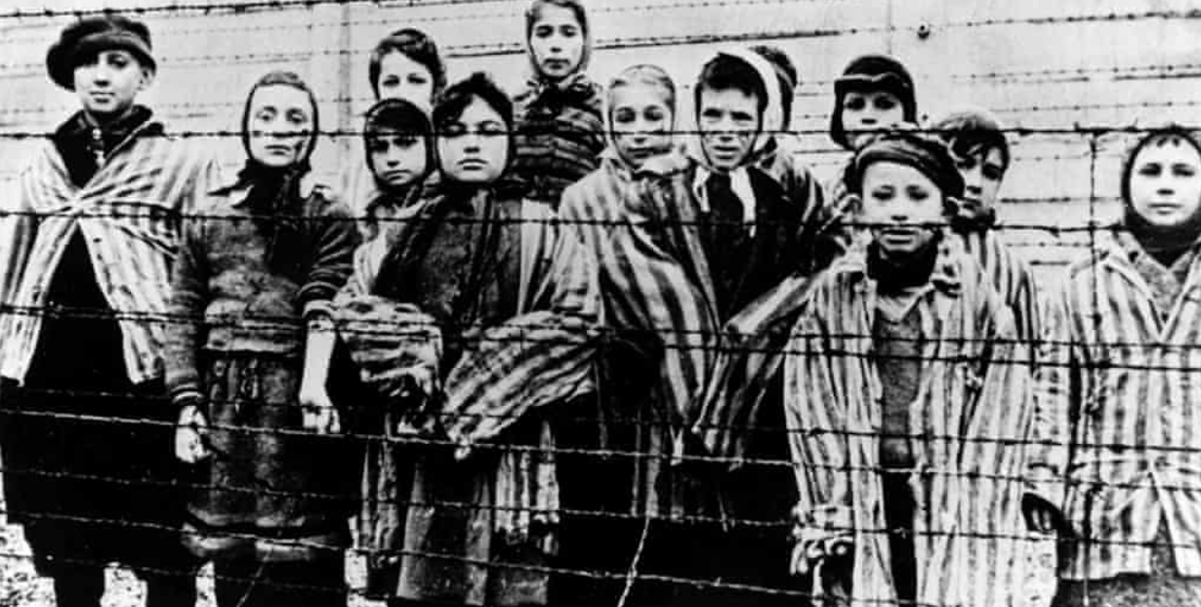
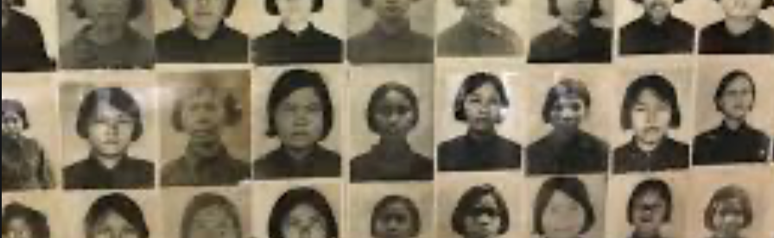
Tyrannies
Hitler, Stalin, Mao—and their little brothers:
Enough said…
Well, maybe not enough said: the peculiar thing was that (most of?) these tyrannies were powered by ideas about economic organization
2:45 audio
Notes:
Hitler, Stalin, Mao—and their little brothers. Enough said…
Well, maybe not enough said: the peculiar thing was that (most of?) these tyrannies were powered by ideas about economic organization

Slide 29

Wealth Gulfs
Wealth gulfs of a magnitude previously unbelievable:
Pre-1870 societies simply were not rich enough for modern second gilded age degrees of wealth inequality to be possible
2:45 audio
Notes:
Wealth gulfs of a magnitude previously unbelievable
Pre-1870 societies simply were not rich enough formodern second gilded age degrees of wealth inequality to be possible

Slide 30
Mismanagement
How do we duplicate—online—the “active learning” components that the in-person university does as a matter of course?:
Failures of management
Mass unemployment
Karl Polanyi’s insights:
The market economy recognizes only property rights
But people think they have rights to land, labor, and finance
Land: a stable community, and an absence of negative externalities
Labor: a right to a stable income commensurate with what one deserves (and to appropriate income and status differentials: unequals should be treated unequally)
Finance: that the stability of one’s job and one’s business not depend on incomprehensible decisions of financiers thousands of miles away
2:45 audio
Notes:
Failures of management
Mass unemployment
Karl Polanyi’s insights:
The market economy recognizes only property rights
But people think they have rights to land, labor, and finance
Land: a stable community, and an absence of negative externalities
Labor: a right to a stable income commensurate with what one deserves (and to appropriate income and status differentials: unequals should be treated unequally)
Finance: that the stability of one’s job and one’s business not depend on incomprehensible decisions of financiers thousands of miles away

Slide 31
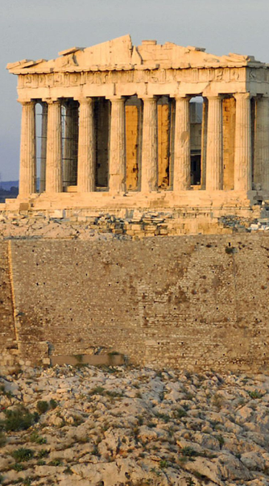
Lecture: 1.3.4. Slouching Towards Utopia?
The first century in which we can think that a truly human world may soon be within our grasp…
Amazingly productive human accomplishments
A great deal of increase in and spread of human freedom
But a lot has gone wrong in the process
War and tyranny
Slow technological and organizational diffusion
The development of underdevelopment
Wealth gulfs
So what do we need other than material abundance to build a utopia?
Does Keynes have anything to tell us?
Does Diamond?
3:00 of audio in this slide; 9:30 in this slide group
Notes:
On the slide are two substantial quotes about the experience and utility of reading books for education. One was written in the early 1500s by intellectual, bureaucrat, and statesman Niccolo Machiavelli of the republic of Florence, Italy. The other was written down in the early -300s by the philosopher Plato of the Republic of Athens, Greece, reporting or claiming to report the words of his teacher Sokrates. Pause this audio track, read the two quotations, and think about them.
Machiavelli, as portrayed by himself, and Sokrates, as portrayed by Plato, have diametrically opposed views of the usefulness of books. For Machiavelli, a book is almost as good as being there with the author—indeed, books are better, because Machiavelli in his library has many authors, all at his beck and call. Sokrates, by contrast, appears to think that books are very likely to be misread and misinterpreted: “they cannot defend themselves", "they do not know to whom they should reply, to whom not”.
For Sokrates, real education is only conducted by a teacher skilled in the art of dialectic—of getting a true dialogue going that leads the student to think for themself and thus have planted in their brain “words which are able to help themselves”, which will then “make the possessors… happy to the utmost extent of human happiness”.
Machiavelli, by contrast, thinks that education is accomplished by simply throwing somebody with leisure to read into a library.
For most people almost all of the time, for some people most of the time, and for all people at least some of the time, Sokrates was right: it is hard work to learn anything but the most partial and evanescent knowledge from books. That was the point of the Andy Matuschak reading—and I hope you got that point, although right now I am wondering if starting this course by asking you to learn something by reading an article was a smart thing for me to have done.
Andy Matuschak has ideas about how to reorganize and restructure books to make reading easier, or at least better from an educational point of view. And—his complaints about university courses that consist of badly taught lectures aside—I think it is fruitful to think of universities-as-institutions as scaffoldings and support systems to make deep and durable learning from books and other media easy, or easier, or at least possible: although you cannot lead a horse to water, you cannot make them drink if they do not want to.
We now face the problem of reproducing what makes a university work—what makes students at a well-functioning university more like Machiavellis and less like the hapless students of Sokrates, who are able to learn only through the deep, focused, personal attention of one of the greatest minds known to us in human history.
How are we going to manage to accomplish this?
——
Lecture: Sokrates vs. Machiavelli on the Educational Process
Machiavelli:
I… put on the garments of court and palace… step inside the venerable courts of the ancients, where, solicitously received by them, I nourish myself on that food that alone is mine and for which I was born; where I am unashamed to converse with them and to question them about the motives for their actions, and they, out of their human kindness, answer me. And for four hours at a time I feel no boredom, I forget all my troubles, I do not dread poverty, and I am not terrified by death…
Sokrates:
The creations of the painter have the attitude of life, and yet if you ask them a question they preserve a solemn silence…. [Words] once written down they are tumbled about anywhere among those who may or may not understand them, and know not to whom they should reply, to whom not… and they cannot protect or defend themselves…. Would a husbandman… take the seeds… and in sober seriousness plant them during the heat of summer?… The serious pursuit of the dialectician… finding a congenial soul, by the help of science sows and plants therein words which are able to help themselves… and have in them a seed which others brought up in different soils render immortal, making the possessors of it happy to the utmost extent of human happiness…

Slide 32

Our Difficult Task
How do we duplicate—online—the “active learning” components that the in-person university does as a matter of course?:
MOOCs did not cut it…
The people who could learn from MOOCs are the Machiavellis—the people who turn their books into sub-Turing class instantiations of the books’ authors, and have conversations with them
Thus a MOOC, for those who could learn effectively from it, was little better than and a lot more expensive than a book
We need a plan for those of you—which is most of us—who are not Machiavellis, but rather like Sokrates’s students
People who really need a tutorial…
A professor, a GSI, a roommate, a classmate, a study group…
2:45 audio
Notes:
How do we duplicate—online—the “active learning” components that the in-person university does largely as a matter of course, and that truly skilled readers like Machiavelli did whenever they entered into their libraries and thus began a dialogue with, say, the then-1500 years dead Roman historian Titus Livius?
About a decade ago there was great enthusiasm for MOOCs—massive open online courses—as a way that, as MOOC enthusiast Sebastian Thrum then put it, he could teach tens of thousands worldwide rather than mere hundreds at Stanford. B
ut MOOCs did not cut it.
It turned out, you see, that the people who could learn from MOOCs were the Machiavellis. There are people who can turn their books in front of their eyes into sub-Turing class instantiations of the books’ authors, and have deep conversations with them: “I am unashamed to converse with them and to question them about the motives for their actions, and they, out of their human kindness, answer…” said Machiavelli. Contrast Sokrates’s students, for whom the words on the page are like “the creations of the painter [which] have the attitude of life, and yet if you ask them a question they preserve a solemn silence…. You would imagine that they had intelligence”, but they do not.
MOOCs turned out to be very like books. For those who could learn effectively from them they were fine—but also little better than and a lot more expensive than a book. For those who could not actively read books to get deep and durable learning out of them, we found out that very few of them could “take” MOOCs and do much better.
Our problem here is that now the coronavirus is largely forcing us into MOOC-land, will-we, nill-we. And as much as we want to nill-we, I do not see how we can this fall. Yes, I firmly intend to hold class this fall in LeConte 4 Tu & Th 15:30-17:00 P[D|S]T. But I do not think that the public health authorities will let more than 20 out of 150 students into the room.
So we need a plan for those of you—which is almost all of us—who are not Machiavellis all, but rather much more like Sokrates’s student the hapless Glaukon. People who really need a tutorial—from a professor, a GSI, a roommate, a classmate, a study group, & c. In the university such tutorials are easy or at least straightforward to find or at least happen by accident with considerable frequency. But online?
We face a difficult task indeed.

Slide 33

Lecture: 1.3.5. Edward Bellamy: Looking Backward
Edward Bellamy: Looking Backward <https://delong.typepad.com/files/bellamy-backward.pdf>: Perhaps the third best-selling novel of the 19th century in the United States
2000 is a utopia…
The narrator is carried forward in time from 1887-2000 by an implausible plot device:
‘“This is the tenth day of September in the year 2000, and you have slept exactly one hundred and thirteen years, three months, and eleven days…”’
He then wanders around, looking at the utopia of 2000…
The opening:
‘“How could I live without service to the world?” you ask…. The answer is that my great-grandfather had accumulated a sum of money on which his descendants had ever since…. The sum had been originally by no means large. It was, in fact, much larger now that three generations had been supported upon it in idleness, than it was at first…’

Slide 34
The Stagecoach of Society
Those who ride and this who pull:
‘Commiseration was frequently expressed by those who rode for those who had to pull the coach, especially when the vehicle came to a bad place in the road, as it was constantly doing, or to a particularly steep hill. At such times, the desperate straining of the team, their agonized leaping and plunging under the pitiless lashing of hunger, the many who fainted at the rope and were trampled in the mire, made a very distressing spectacle, which often called forth highly creditable displays of feeling on the top of the coach.
‘At such times the passengers would call down encouragingly to the toilers of the rope, exhorting them to patience, and holding out hopes of possible compensation in another world for the hardness of their lot, while others contributed to buy salves and liniments for the crippled and injured. It was agreed that it was a great pity that the coach should be so hard to pull, and there was a sense of general relief when the specially bad piece of road was gotten over. This relief was not, indeed, wholly on account of the team, for there was always some danger at these bad places of a general overturn in which all would lose their seats.
‘It must in truth be admitted that the main effect of the spectacle of the misery of the toilers at the rope was to enhance the passengers’ sense of the value of their seats upon the coach, and to cause them to hold on to them more desperately than before…

Slide 35
The Stagecoach of Society II
“Finer clay”:
‘The other fact is yet more curious, consisting in a singular hallucination which those on the top of the coach generally shared, that they were not exactly like their brothers and sisters who pulled at the rope, but of finer clay, in some way belonging to a higher order of beings who might justly expect to be drawn. This seems unaccountable, but, as I once rode on this very coach and shared that very hallucination, I ought to be believed.
‘The strangest thing about the hallucination was that those who had but just climbed up from the ground, before they had outgrown the marks of the rope upon their hands, began to fall under its influence. As for those whose parents and grand-parents before them had been so fortunate as to keep their seats on the top, the conviction they cherished of the essential difference between their sort of humanity and the common article was absolute. The effect of such a delusion in moderating fellow feeling for the sufferings of the mass of men into a distant and philosophical compassion is obvious.
‘To it I refer as the only extenuation I can offer for the indifference which, at the period I write of, marked my own attitude toward the misery of my brothers…

Slide 36
The Stagecoach of Society III
Class war:
‘The sanguine argued very forcibly that it was in the very nature of things impossible that the new hopes of the workingmen could be satisfied, simply because the world had not the wherewithal to satisfy them. It was only because the masses worked very hard and lived on short commons that the race did not starve outright, and no considerable improvement in their condition was possible while the world, as a whole, remained so poor.
‘It was not the capitalists whom the laboring men were contending with, these maintained, but the iron-bound environment of humanity, and it was merely a question of the thickness of their skulls when they would discover the fact and make up their minds to endure what they could not cure.
The less sanguine admitted all this. Of course the workingmen’s aspirations were impossible of fulfillment for natural reasons, but there were grounds to fear that they would not discover this fact until they had made a sad mess of society. They had the votes and the power to do so if they pleased, and their leaders meant they should. Some of these desponding observers went so far as to predict an impending social cataclysm. Humanity, they argued, having climbed to the top round of the ladder of civilization, was about to take a header into chaos…’

Slide 37
The Limit of Human Felicity
Technological marvels of 2000: great cities, Amazon drop-shipments, music
Julian West expects Edith Leete to play the piano, but:
‘“Nothing would delight me so much as to listen to you,” I said.
‘“To me!” she exclaimed, laughing. “Did you think I was going to play or sing to you?”
‘“I hoped so, certainly,” I replied.
‘Seeing that I was a little abashed, she subdued her merriment and explained. “Of course, we all sing nowadays as a matter of course in the training of the voice, and some learn to play instruments for their private amusement; but the professional music is so much grander and more perfect than any performance of ours, and so easily com- manded when we wish to hear it, that we don’t think of calling our singing or playing music at all. All the really fine singers and players are in the musical service, and the rest of us hold our peace for the main part. But would you really like to hear some music?”…’

Slide 38
The Limit of Human Felicity II
In the music room:
‘She made me sit down comfortably, and, crossing the room, so far as I could see, merely touched one or two screws, and at once the room was filled with the music of a grand organ anthem; filled, not flooded, for, by some means, the volume of melody had been per- fectly graduated to the size of the apartment. I listened, scarcely breathing, to the close. Such music, so perfectly rendered, I had never expected to hear.
‘“Grand!” I cried, as the last great wave of sound broke and ebbed away into silence. “Bach must be at the keys of that organ; but where is the organ?”…
‘“There are a number of music rooms in the city, perfectly adapted acoustically to the different sorts of music. These halls are connected by telephone with all the houses of the city…. Any one of the four pieces now going on that you prefer, you can hear by merely pressing the button which will connect your house-wire with the hall where it is being rendered…”’

Slide 39
The Limit of Human Felicity III
Four live orchestras you can listen to on the speakerphone!
‘“It appears to me, Miss Leete,” I said, “that if we could have devised an arrangement for providing everybody with music in their homes, perfect in quality, unlimited in quantity, suited to every mood, and beginning and ceasing at will, we should have considered the limit of human felicity already attained, and ceased to strive for further improvements…”’

Slide 40
1.3. Zoom Q&A Session: Module: Themes…
Time: Tu Sep 01 15:30 PDT. Zoom URL: TBA.
Questions:
First, what were the processes that launched themselves around 1870 that have made twentieth century economic history so distinctive?
How do all of the nine—nine!—themes of this century’s history tie together?
We have we not done a better job of producing human flourishing with our wealth?
Should we think about the history with more themes? Fewer themes? Which themes?
80 min zoom q&a session (starts 15:30 PDT Berkeley time—i.e. 15:40)

Slide 41
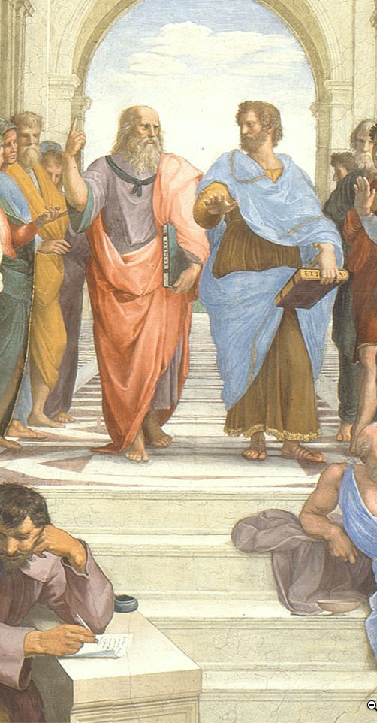
Takeaways from & Extensions of Ideas…:
1.4. Asynchronously Write & Discuss: Grand Narrative & Themes Module…
Let me start this threaded asynchronous discussion off by asking three questions:
What important things that happened in the Long 20th Century have not been mentioned so far in this course?
What things that happened that have been mentioned are distractions?
In what ways is DeLong wrong in his claim that practically everything interesting and important in 20th century history is rooted in the economic changes launched by the coming of (1) the industrial research lab, (2) the modern bureaucratic and routinized corporation, (3) globalization in trade, communications, and migration; and (4) American exceptionalism?
As before, for full credit for this discussion, provide at least two substantive contributions to the discussion, of which at most one should be a direct response to one of my questions. We want you to talk to & react to one another here…
THREADED DISCUSSION URL: <https://bcourses.berkeley.edu/courses/1493152/discussion_topics/5774299/>
130 words

Slide 42
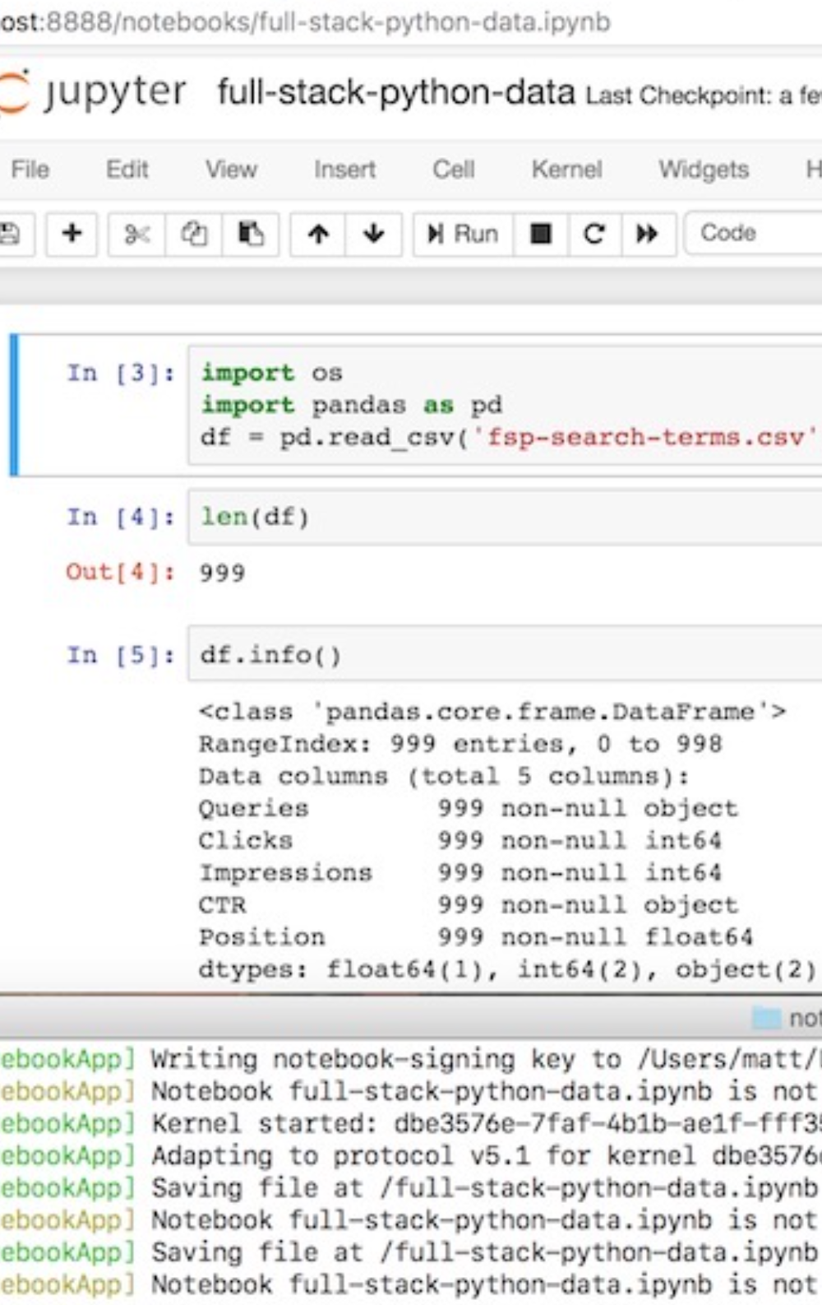
Problem Set 1. Grand Narratives & the Three Watersheds…
JUPYTER NOTEBOOK URL:
<http://datahub.berkeley.edu/user-redirect/interact?account=braddelong&repo=lecture-support-2020&branch=master&path=ps01.ipynb>
Click on (or copy and paste in your browser URL/search field) the link above, and page through the interactive jupyter notebook document, following the instructions…
With what looks to be a permanent and long-run partial moving-online of the university, the already important topic of “data science” seems likely to become even more foundational.
Hence this first problem set tries to provide you with an introduction—to “data science”, and to the framework we will be using for problem sets that we hope will make things much easier for you and for us…
Notes:
PS00 URL: <http://datahub.berkeley.edu/user-redirect/interact?account=braddelong&repo=lecture-support-2020&branch=master&path=ps00.ipynb>
With answers: <https://nbviewer.jupyter.org/github/braddelong/lecture-support-2020/blob/master/ps00-answers.ipynb>

Slide 43
8-Person Breakout §
Write up and submit a one-page Google doc outline for a five minute talk on:
What would be a better—or, at least, more relevant to your interests—set of themes for a survey of twentieth century economic history than the ones presented here? No fewer than five themes. No more than 10.
Ten students a week will be asked to give such a talk based on the Google doc they constructed, over zoom, to one of the teaching staff…
GOOGLE DOC URL: <>
130 words

Slide 44
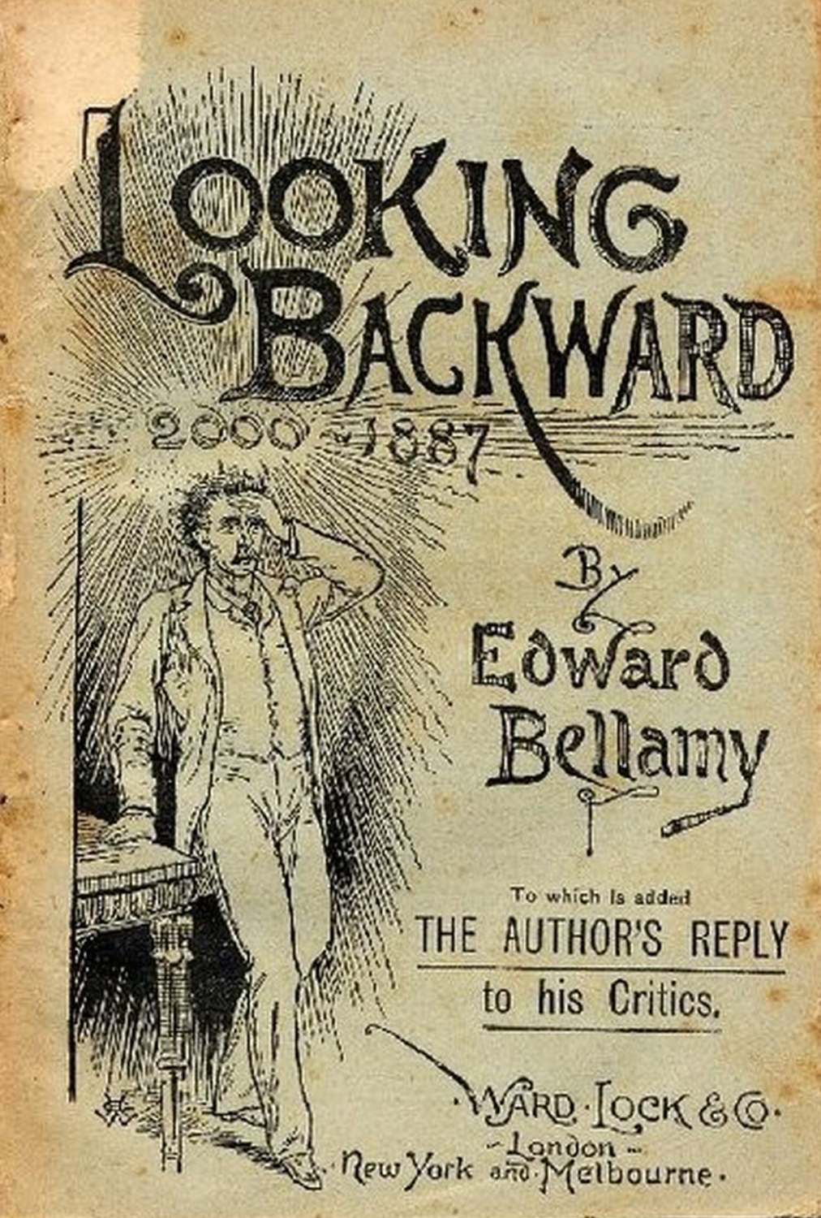
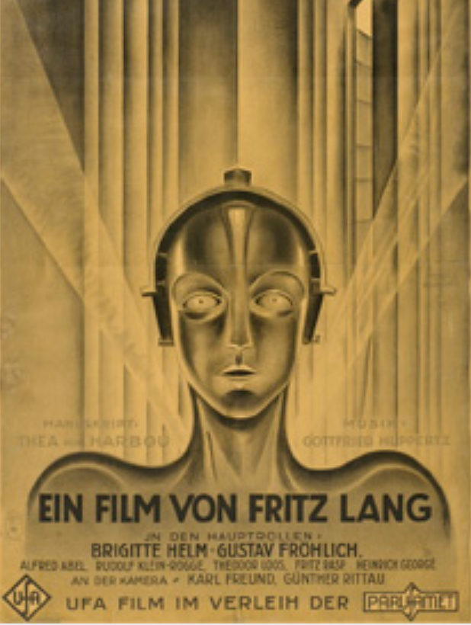
Learning Goals & Orienting Questions for: Module 1. Themes
Primary:
Set out, from an eagle’s-eye standpoint, how human societies worked in the long agrarian age, from 10,000 to 250 years ago.
Set out, again from an eagle’s eye standpoint, how thin the veneer of “modernity” was on top of agrarian-age societies even in the Industrial Revolution era from 250 to 150 years ago.
Set out the principal drivers of the greatest transformation in human economic (and, I would argue, one of the greatest transformations in all human) history
Recite and place in context the ten big themes of the economic history of the long 20th century: the axis of history economic… explosion of wealth… cornucopia of technology… demographic transition… feminist revolution… empowered tyrannies… wealth gulfs… inclusion and hierarchy attenuation… mismanagement and insecurity… and American exceptionalism…
Secondary:
Assess to what degree you agree with and to what degree you think the argument of Jared Diamond that the development of agriculture was a horrible mistake is grossly overstated
Assess to what degree you agree with and to what degree you think the argument of Patricia Crone that all previous economies were—from our standpoint—extraordinarily focused on domination and surplus extraction is grossly overstated
Explain what other possible starting and ending dates for a history of “the 20th century” might be, and how they might lead to a different picture and interpretation of history
Propose and argue for the highlighting as primary and significantly most important of at most four of the ten “big themes” of the economic history of the long 20th century
Propose and argue for the deletion as secondary distractions of at least three of the ten “big themes” of the economic history of the long 20th century
Propose and argue for better replacements for at least three of the ten “big themes” of the economic history of the long 20th century.
Set out, again from an eagle’s-eye standpoint, what life is like in the global north today and how it is different from life in 1870…
Set out, again from an eagle’s-eye standpoint, what life is like in the global south today and how it is different from life in 1870…
Link
Link
240 words

Slide 45
Readings & c. for: Module 1. Themes
Required:
J. Bradford DeLong (2020): Slouching Towards Utopia: An Economic History of the Long 20th Century <https://github.com/braddelong/public-files/tree/master/econ-115-f2020-textbook>, chapter 1. Introduction: The Grand Narrative
J. Bradford DeLong (2020): Slouching Towards Utopia: An Economic History of the Long 20th Century <https://github.com/braddelong/public-files/tree/master/econ-115-f2020-textbook>, chapter 2. Themes: From Science & Technological Cornucopia to Feminism & Gilded Ages
Jared Diamond (1999): The Worst Mistake in the History of the Human <https://github.com/braddelong/public-files/blob/master/readings/article-diamond-agriculture.pdf>
John Maynard Keynes (1931): Economic Possibilities for Our Grandchildren <https://github.com/braddelong/public-files/blob/master/readings/article-keynes-possibilities.pdf>
Further:
Patricia Crone (1989): Pre-Industrial Societies <https://github.com/braddelong/public-files/blob/master/readings/selections-crone-pre.pdf>
Link
Link
240 words

Slide 46
Catch Our Breath…
Ask a couple of questions?
Make a couple of comments?
Any more readings to recommend?
<>

Slide 47
U.C. Berkeley: Economics 115: Fall 2020
The World Economy in the Long 20th Century: 1870-2016
Brad DeLong
Department of Economics & Blum Center, U.C. Berkeley; & WCEG
delong@econ.berkeley.edu
last revised: 2020-05-23
for delivery: 2020-08-29
Fall 2020 instantiation: <https://bcourses.berkeley.edu/courses/1493152>
On github: <https://github.com/braddelong/public-files/blob/master/econ-115-master.pptx>
Master file: <https://www.icloud.com/keynote/0oWNqxKlrwJZn8H1UbIfG-LBg>

Slide 48
Modules
Notionally: a sixteen week semester—the last week being review, & the first week getting off to a somewhat ragged start…
0. As class begins… <<https://www.icloud.com/keynote/0FVJH3UuqPuq91KpU0jRc1vRQ>
Themes
Growth & globalization 1870-1914
Empire & underdevelopment: 1870-1914
World War I & failed reconstruction: 1907-1929
The Great Depression: 1925-1941
Alternatives to the ‘classical liberal’ order: 1870-2016
World War II & cold war: 1933-1989
30 glorious years in the global north: 1945-1975
False (& true) starts to development in the global south: 1911-1990
The neoliberal turn: 1980-2005
Hyperglobalization & infotech: 1955-2016
The great recession & secular stagnation: 2005-2016
East Asia’s rise: 1870-2016
Ending the long 20th century: 2005-2016
Conclusion: looking back & looking forward: -3000-3000
Link
Link

